Slide 1
E-COMMERCE · DATA ANALYTICS
OLIST E-COMMERCE
STORE ANALYSIS
Business Insights & Performance Analysis
MODULES : EXCEL · SQL · POWER BI · TABLEAU

Slide 2
AGENDA
Business & Data Overview
Sales & Customer Analysis
Product, Seller & Operational Analysis
Insights & Recommendations
From business context to evidence-backed recommendations.

Slide 3
ORDERS
CUSTOMERS
99,441
96,096
orders processed through the marketplace
customers served
BUSINESS & DATA OVERVIEW
SELLER NETWORK
TOTAL REVENUE
OLIST E-COMMERCE ANALYSIS OVERVIEW
3,095
R$16.01M
Five measures establish the scale of the marketplace before deeper analysis.
sellers across multiple categories
in total payment value
ORDER ITEMS
112,650
items processed

Slide 4
SALES PERFORMANCE
REVENUE LEADER
SALES & ORDER PERFORMANCE
November 2017
Contributed the highest revenue approximately R$1.18M
ANALYTIC VIEW
Show orders and revenue trends over time, plus average order value where available.
Orders - 7,544
Average order value ~R$157
PEAK SALES PERIOD
1
2
3
4
November 2017
Recorded the strongest sales performance, driven by the Black Friday period.
November 2017 generated approximately R$1.18M revenue and
had around 7,544 orders.
Revenue - R$1.18M
November 2017
ORDER TREND
Increasing → Peak → Fluctuating
Recommendation: Align marketing, inventory, and promotions with high-performing periods, particularly seasonal events such as Black Friday.
Orders increased strongly throughout 2017, reaching their peak in
November 2017, followed by fluctuations during 2018.

Slide 5




CUSTOMER & GEOGRAPHIC ANALYSIS
CUSTOMER & GEOGRAPHIC ANALYSIS
Compare customers, orders, and revenue by Brazilian state.
Customer concentration
Revenue leader
SAO PAULO 41,746 customers - the highest customer concentration
representing about 42% of the customer base.
SAO PAULO Generated approximately R$5.77M in revenue,
the highest among all states.
Geographic opportunity
Operational use
Rio de Janeiro (RJ) & Minas Gerais (MG)
Strong secondary markets with 12,852 customers in RJ and 11,635
in MG, making them good targets for regional growth.
Use regional demand patterns for marketing, delivery, and expansion.

Slide 6
DELIVERY
LATE DELIVERY
11.37 DAYS
8.11%
Average delivery time
Late delivery rate
PAYMENT
REVIEWS
OPERATIONS & EXPERIENCE
CREDIT CARD
4.09/5
DELIVERY, PAYMENT & CUSTOMER EXPERIENCE
Most used payment method
Average review score
ANALYTICAL QUESTION
Does longer delivery time contribute to lower review scores?
Connect operational performance with the customer experience.
Recommendation: Improve logistics and experience in weaker regions and categories

Slide 7
END-TO-END METHOD
DATA ANALYSIS APPROACH
Each tool transformed the Olist dataset from raw transactions into actionable business insights.
Excel
Power BI
Data cleaning, preparation, pivot tables, exploratory analysis
Data modeling, DAX measures, interactive KPIs
1
2
3
4
SQL
Tableau
Data extraction, business queries, aggregations, KPI analysis
Interactive visualizations, trend and geographic analysis

Slide 8
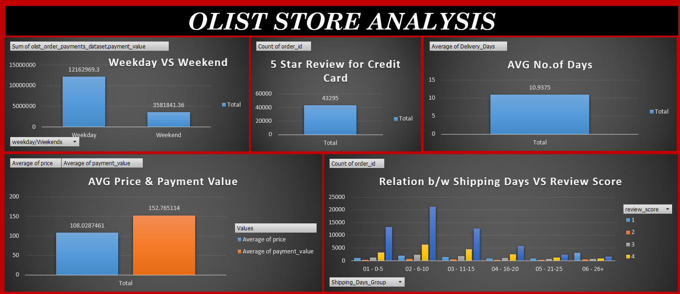
Excel Dash Board

Slide 9
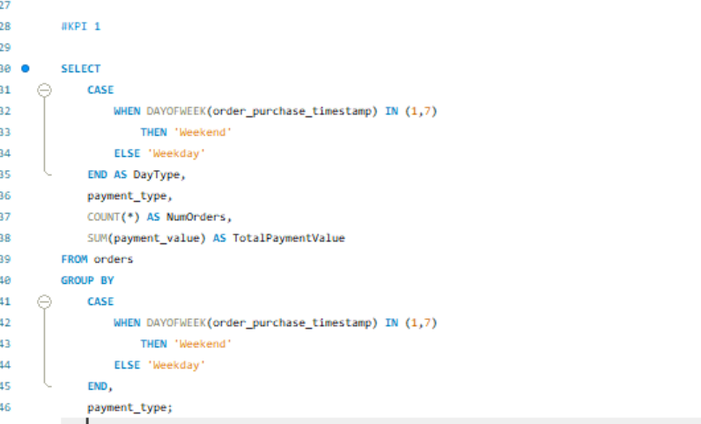
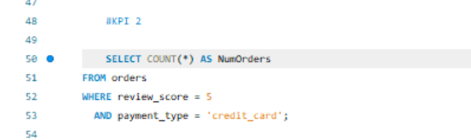
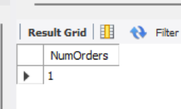
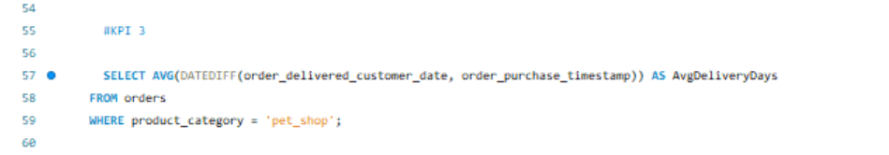
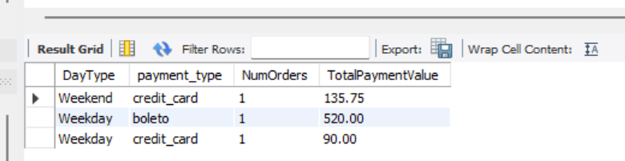
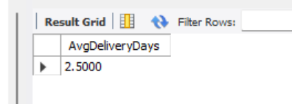
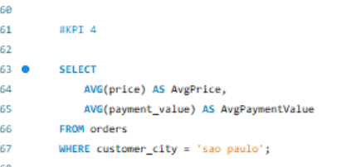
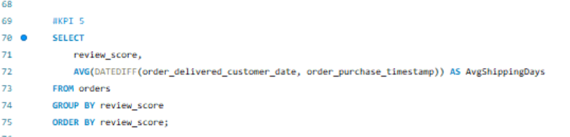
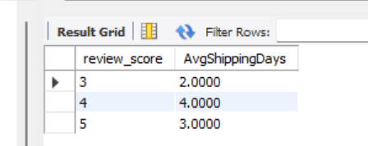
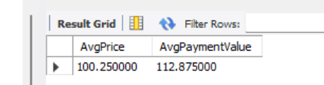
SQL QUERIES

Slide 10
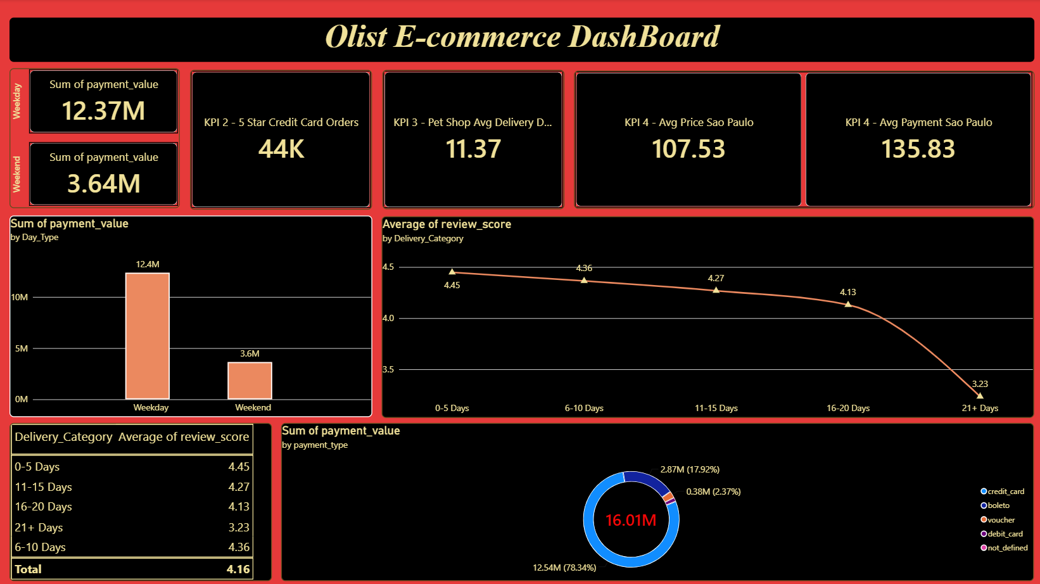
Power BI Dash Board

Slide 11
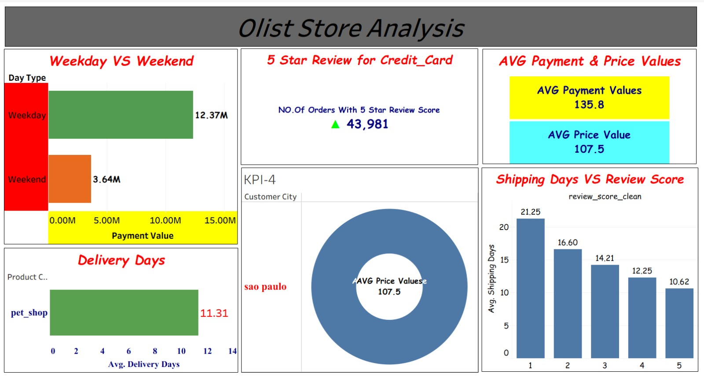
Tableau Dash Board

Slide 12
01
02
Sales performance
Customer behavior
Strongest sales periods and revenue-generating categories identified
Major customer regions and purchasing patterns identified
INSIGHTS
SUMMARY OF KEY INSIGHTS
03
04
Product & seller performance
Delivery & operations
High-performing categories and sellers highlighted
Longer delivery times and operational challenges surfaced
Five lenses connect marketplace performance to customer experience.
05
Customer satisfaction
Review patterns and experience drivers analyzed

Slide 13
ACTION PLAN
STRATEGIC RECOMMENDATIONS & CONCLUSION
Strengthen high-performing categories: Increase inventory and promotional support
Improve delivery performance: Focus on regions with high delivery times and late orders
Support high-performing sellers: Replicate proven marketplace practices
Target regional opportunities: Use state-level demand and revenue patterns
Improve customer experience: Address delivery and product areas linked to lower reviews
Excel, SQL, Power BI, and Tableau combine to turn marketplace data into decisions about sales, customers, products, sellers, delivery, and satisfaction.
DATA → ANALYSIS → INSIGHTS → BUSINESS DECISIONS

Slide 14
Thank You….

